Slide 1


Major/Minor Project
Title: AI Based Tourism Pressure and Ecosystem Stress Prediction
(Uttarakhand Char Dham)
Presented by:
R2142230152 - Sangam Khanna
R2142230154 - Manan Nasa
Mentored By
Dr. Sachi Choudhary

Slide 2
Content
Introduction
Literature Review
Objectives
Methodology
Working Model
Results
Conclusion
References
Colour Code:
Synopsis: Red
Mid term: Orange
End Term: Purple
Note: The Following presentation will have all the content of the later.

Slide 3
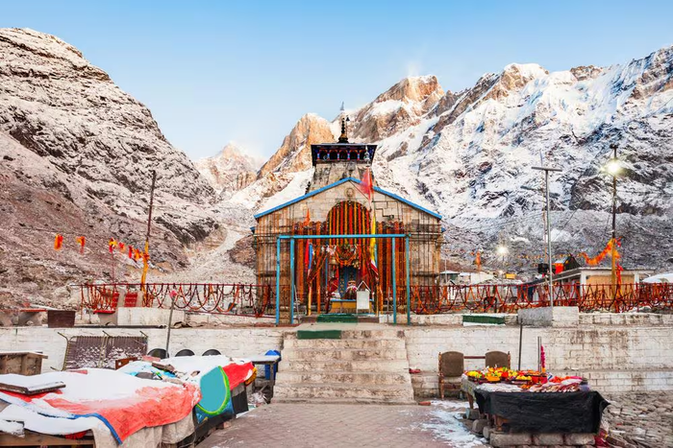
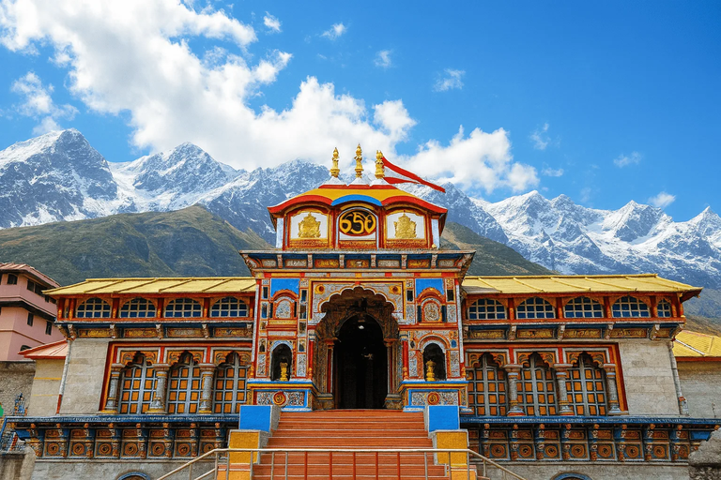
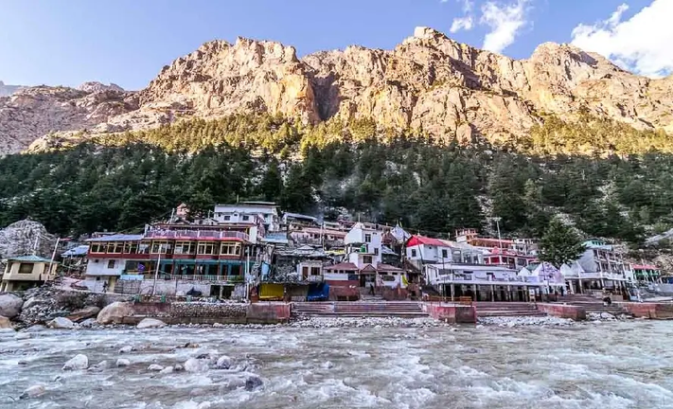
Introduction
Tourism plays a significant role in the economy of Uttarakhand, particularly in the Char Dham region comprising Kedarnath, Badrinath, Gangotri, and Yamunotri. Every year, heavy seasonal pilgrimage leads to a sudden surge in visitor numbers, placing immense pressure on the fragile Himalayan ecosystem. This rapid increase in tourism contributes to environmental challenges such as deforestation, excessive waste generation, water overuse, land-use changes, and climate-related impacts. Managing this pressure in a sustainable manner has become increasingly important.
This project aims to develop an AI-based model to analyze and predict ecosystem stress caused by tourism activities. By integrating tourism statistics, satellite imagery, and climate data, the system applies time-series forecasting, regression techniques, and GIS analysis to identify tourism thresholds and assess environmental risk levels. The ultimate goal is to support data-driven decision-making and promote sustainable tourism planning in the Char Dham region.

Slide 4




Technical Cocepts USed
The project combines data analytics, machine learning, and visualization technologies.
Key technologies used:
• Python – Core programming language
• Pandas – Data processing and cleaning
• Streamlit – Interactive dashboard development
• Plotly – Advanced data visualization
• Random Forest Regressor – Climate-based prediction model
• ARIMA Time Series Model – Forecasting future tourist trends
• SHAP Explainability – Interpreting machine learning predictions

Slide 5
Literature Review
Inference from Literature
From previous research we observe:
• Tourism demand forecasting can help manage overcrowding.
• Climate variables significantly influence tourist behavior.
• Environmental monitoring is essential in fragile ecosystems.
However, most existing systems do not integrate tourism data, climate data, and AI prediction together in a single dashboard.
1) Tourism Carrying Capacity Studies
Researchers have studied the impact of excessive tourism on fragile ecosystems, especially in pilgrimage destinations like the Himalayas.
2) Tourism Demand Forecasting Models
Several studies use ARIMA and regression models to predict tourism demand.
3) Environmental Monitoring using Remote Sensing
Satellite imagery and NDVI analysis are used to monitor vegetation health and environmental stress.
4) Smart Tourism Systems
Recent studies integrate AI and data analytics to improve tourism management.

Slide 6
Objective
Study the relationship between climate variables and tourist arrivals.
Develop machine learning models to predict future tourist numbers.
Calculate an Ecosystem Stress Index (ESI) combining tourism pressure and climate factors.
Build an interactive dashboard for visualization and early warnings.

Slide 7


Methodology
Steps
1) Data Collection
Tourism and climate datasets are collected from public sources.
2) Data Preprocessing
Datasets are cleaned, merged, and formatted.
3) Exploratory Data Analysis
Visualization of tourism trends and climate relationships.
4) Machine Learning Modeling
Two prediction models are implemented:
• Random Forest Regressor
• ARIMA Time Series Model
5)Dashboard Development
An interactive dashboard is created using Streamlit and Plotly.

Slide 8
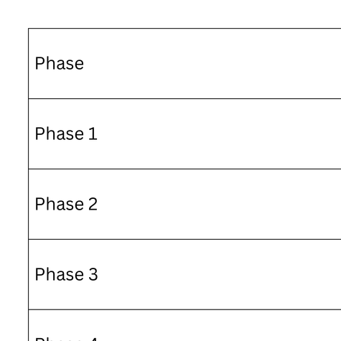
Methodology
Timeline

Slide 9
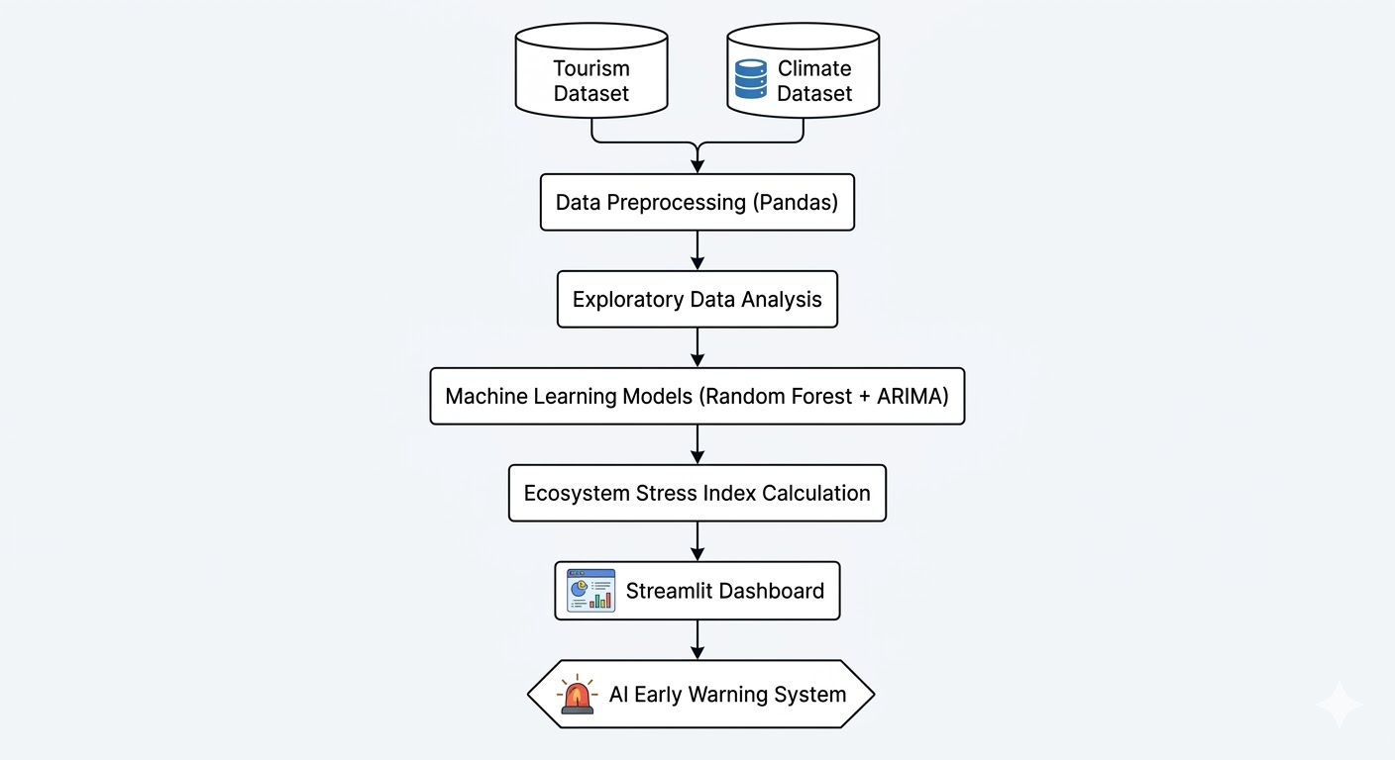
Technical Diagram

Slide 10
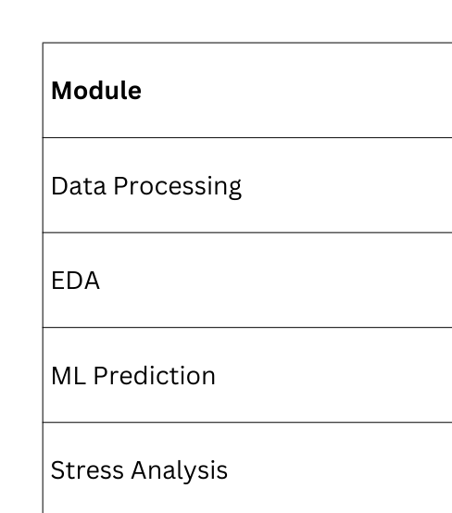
Modules

Slide 11
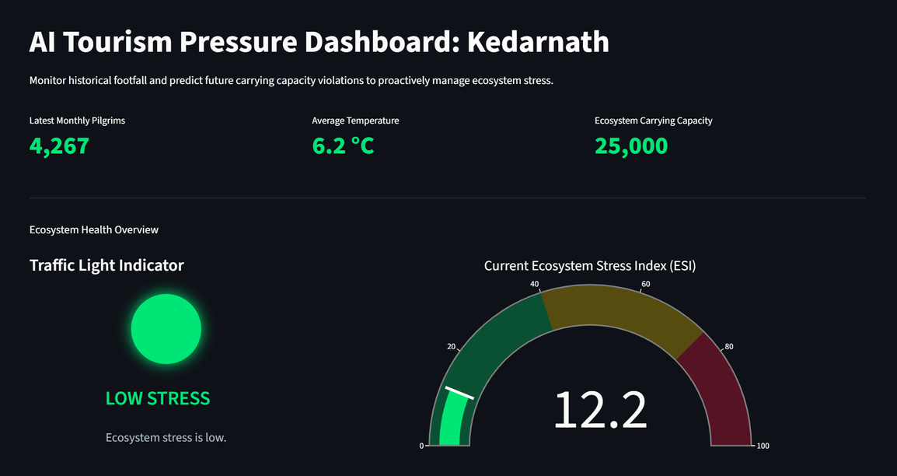
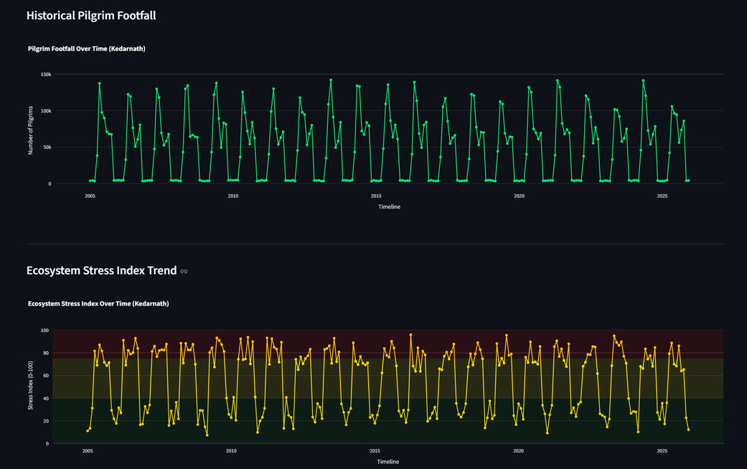
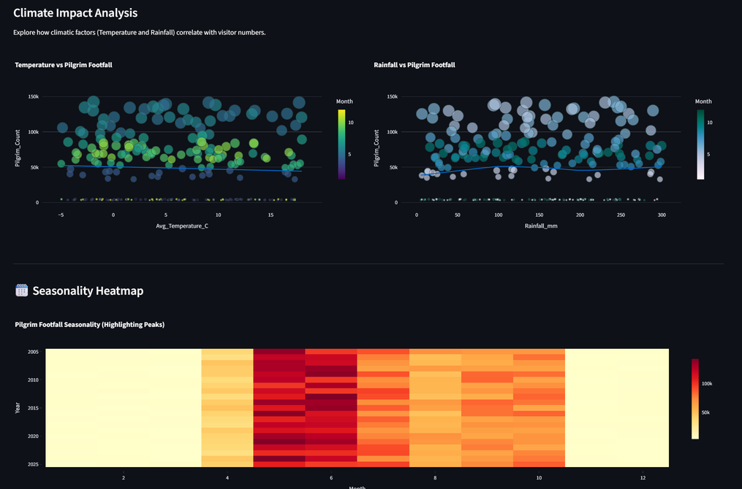
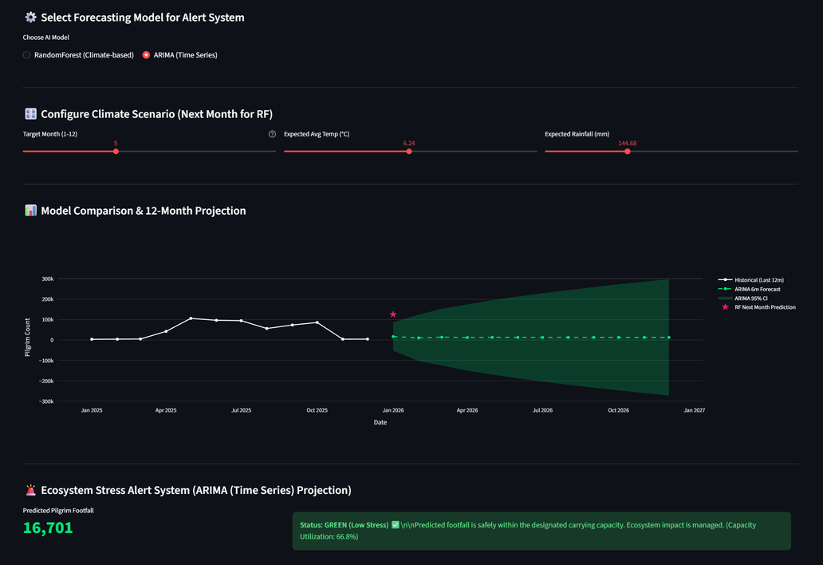
Working Model

Slide 12
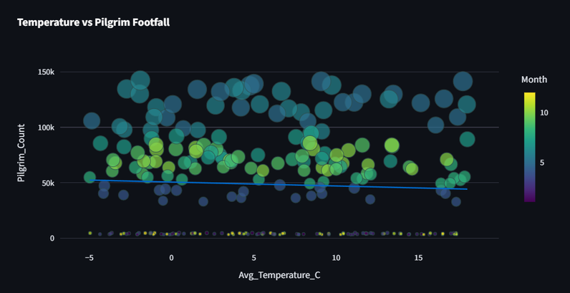
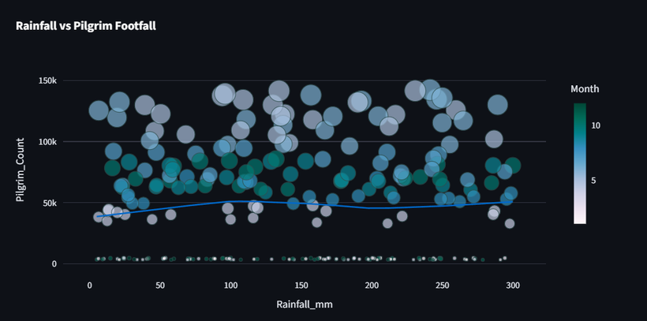
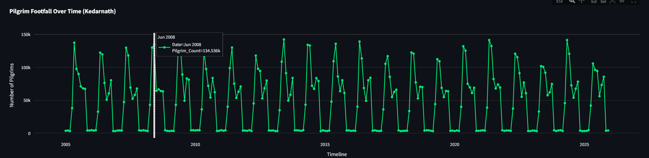
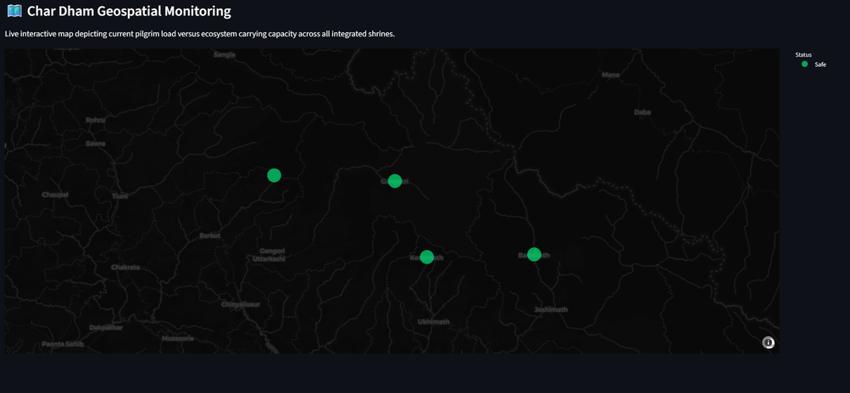
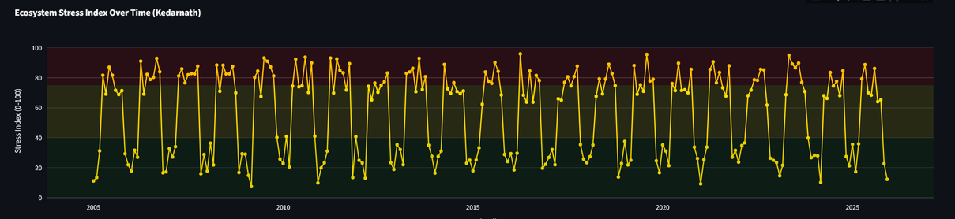
Results
Outcome Graphs
• Pilgrim Footfall Trend
• Ecosystem Stress Index Trend
• Climate Impact Scatter Plots
• Seasonality Heatmap
• Correlation Matrix
• Forecast Comparison Graph
• Geospatial Monitoring Map

Slide 13
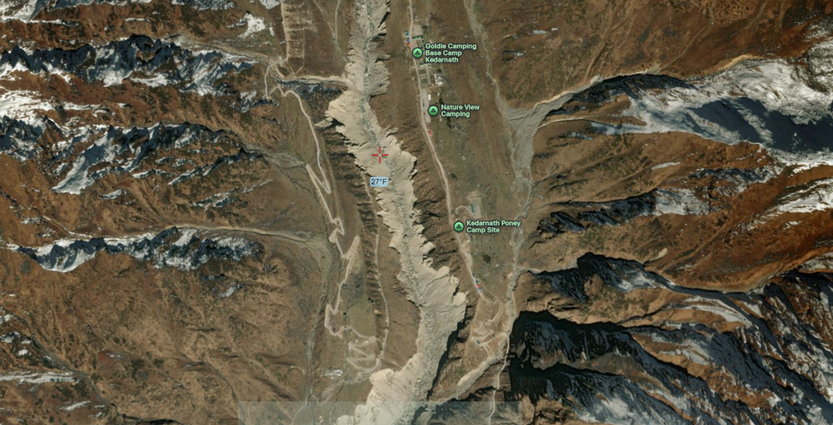
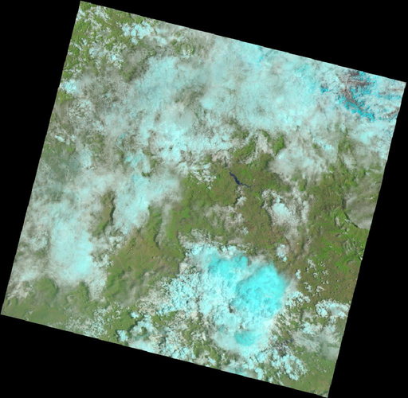
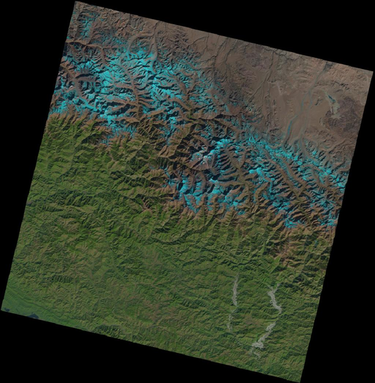
Conclusion
Justification of Objectives
The project successfully demonstrates:
• AI-based prediction of tourism pressure
• Visualization of ecosystem stress indicators
• Early warning system for environmental risk
Future Scope
Future extensions include:
• Integration of satellite NDVI vegetation data
• Real-time weather API integration
• Waste generation monitoring
• Crowd density detection using mobile data
• Government tourism policy decision support

Slide 14
Reference
Tourism Data & Reports
Sacred Yatra - Char Dham Pilgrim Statistics
Uttarakhand Tourism Development Board
SDC Foundation - Char Dham Yatra Data Analysis Report (2024)
Research Papers
Tourism Pressure in Himalayan Pilgrimage Regions
Sustainability & Environmental Management of Pilgrimage Tourism
Climate & Satellite Data Sources
Sentinel Hub EO Browser - Satellite Monitoring
USGS Earth Explorer - Landsat Satellite Data
Waste Management Studies
Solid Waste Management in Himalayan Tourist Areas
Environmental Challenges in Pilgrimage Centres

Slide 15
Thank You

